Slide 1
Guided Capstone Slide Deck

Slide 2
Problem Identification
Context:
Need to revisit pricing strategy
Use data to increase pricing according to the value of the resort
Currently setting prices based on industry average.
New Chairlift will bring more visitors, but increase operating cost by $1,540,000
Currently serve 350,000 visitors per season

Slide 3
Problem Identification
Hypothesis:
How can Big Mountain Resort cut costs and adjust their pricing in order to properly capitalize on their facilities; ultimately, to generate as much revenue from it’s 350,000 visitors during the upcoming year?

Slide 4
Recommendation and Key Findings
It is Ideal to pursue Scenario 2:
Increase vertical drop by adding a run to a point 150 feet lower but requiring the installation of an additional chair lift to bring skiiers back up, without additional snow making coverage
A price increase of $2.22 is sustainable and would increase revenue by $3,888,889 for the entire season.
This scenario allows for an increase in price while minimizing costs compared to the other 3 scenarios.

Slide 5
Modeling Results and Analysis
Current Price for an Adult Weekend Ticket - $81
Modelled Price - $97.96
Mean Absolute Error - $10.36
This large mean absolute error suggests that the modeled price of $97.96 isn’t incredibly reliable
Missing valuable data such as:
Operating Costs: Maintenance, staff salaries, marketing expenses, utilities, CapEx
Revenue Streams: Equipment rentals, lessons, rooms, food/beverage sales
Visitor information: Average income, spending habits, Google/Yelp Reviews
Additional data could help the modeled price become more reliable

Slide 6
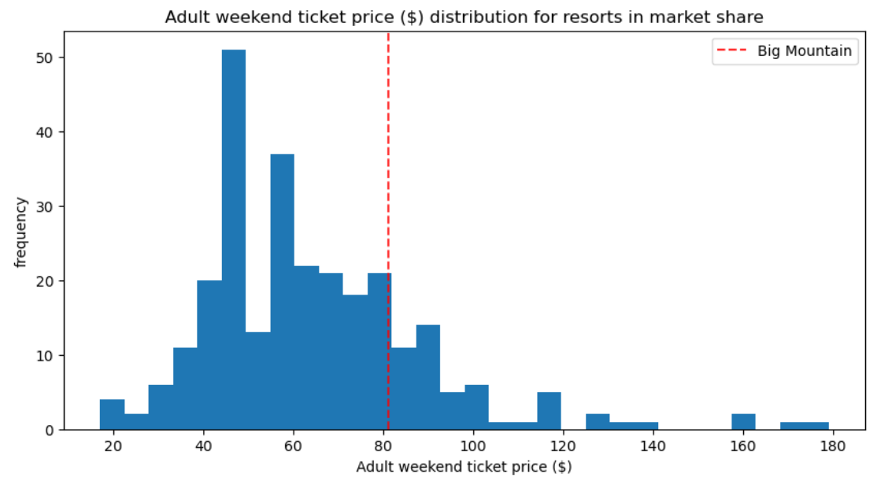
Modeling Results and Analysis
How Big Mountain’s current pricing compares to all resorts in the market.

Slide 7
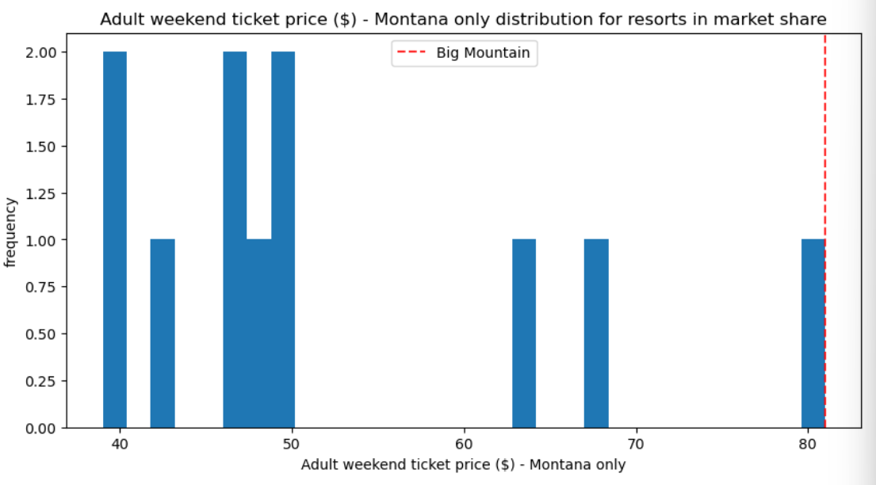
Modeling Results and Analysis
How Big Mountain’s current pricing compares to all resorts in Montana only.

Slide 8
Modeling Results and Analysis
Scenario 1 shows that unless Big Mountain Resort agrees to close ONLY 1 run, they will see a drop in their ticket price, so this is not ideal.
Scenario 2 shows that a ticket price increase of $2.22 is sustainable, and would lead to an increase in revenue of $3,888,889 over the entire season if expected visitors remains at 350,000.
Scenario 3 shows that adding 2 acres of snow making makes no impact on the potential ticket price increase, nor the revenue over the course of the season. Therefore, adding more snow wouldn't increase revenue and would require more resources and could increase operating costs which would hurt the Resort's bottom line.
Scenario 4 also shows no difference in adding 0.2 miles and 4 acres of snow to the longest run, so it's not ideal.
Scenario 2 is the ideal route to explore since it allows to an increase in ticket price and revenue

Slide 9
Summary and Conclusion
Based on the current model, Scenario 2 is the ideal path to explore
Addressing data deficiencies is crucial for more reliable predictions
The large price discrepancy should be explored more in order to align pricing strategies with the real market.
Regular updates to the model and an user friendly interface will be available to Business Analysts for future use.

